Slide 2
ABSTRACT
The provided code demonstrates the creation of a simple desktop application using the Tkinter library in Python. The application features a table implemented with the `ttk.Treeview` widget, allowing the user to input data such as ID, Name, Age, and City. The data is inserted into the table upon clicking an "Add" button. Entry widgets are employed for user input, and the GUI components are organized to facilitate a straightforward and interactive user experience. This example serves as a foundation for developing more complex desktop applications with user interfaces in Python.

Slide 3
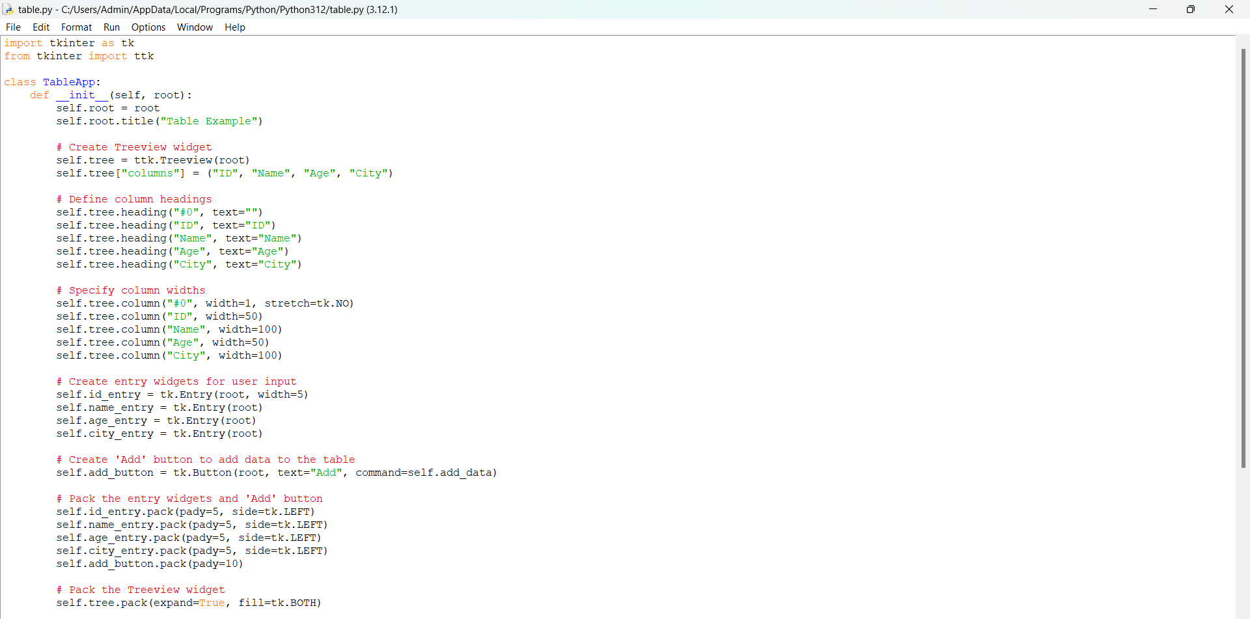
Code

Slide 4
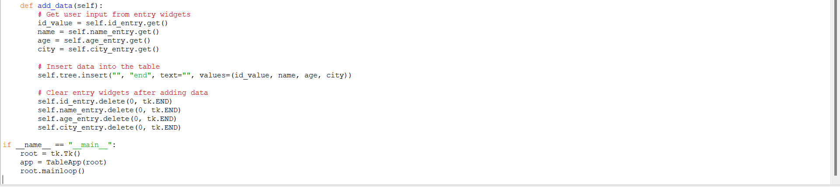
CODE

Slide 5
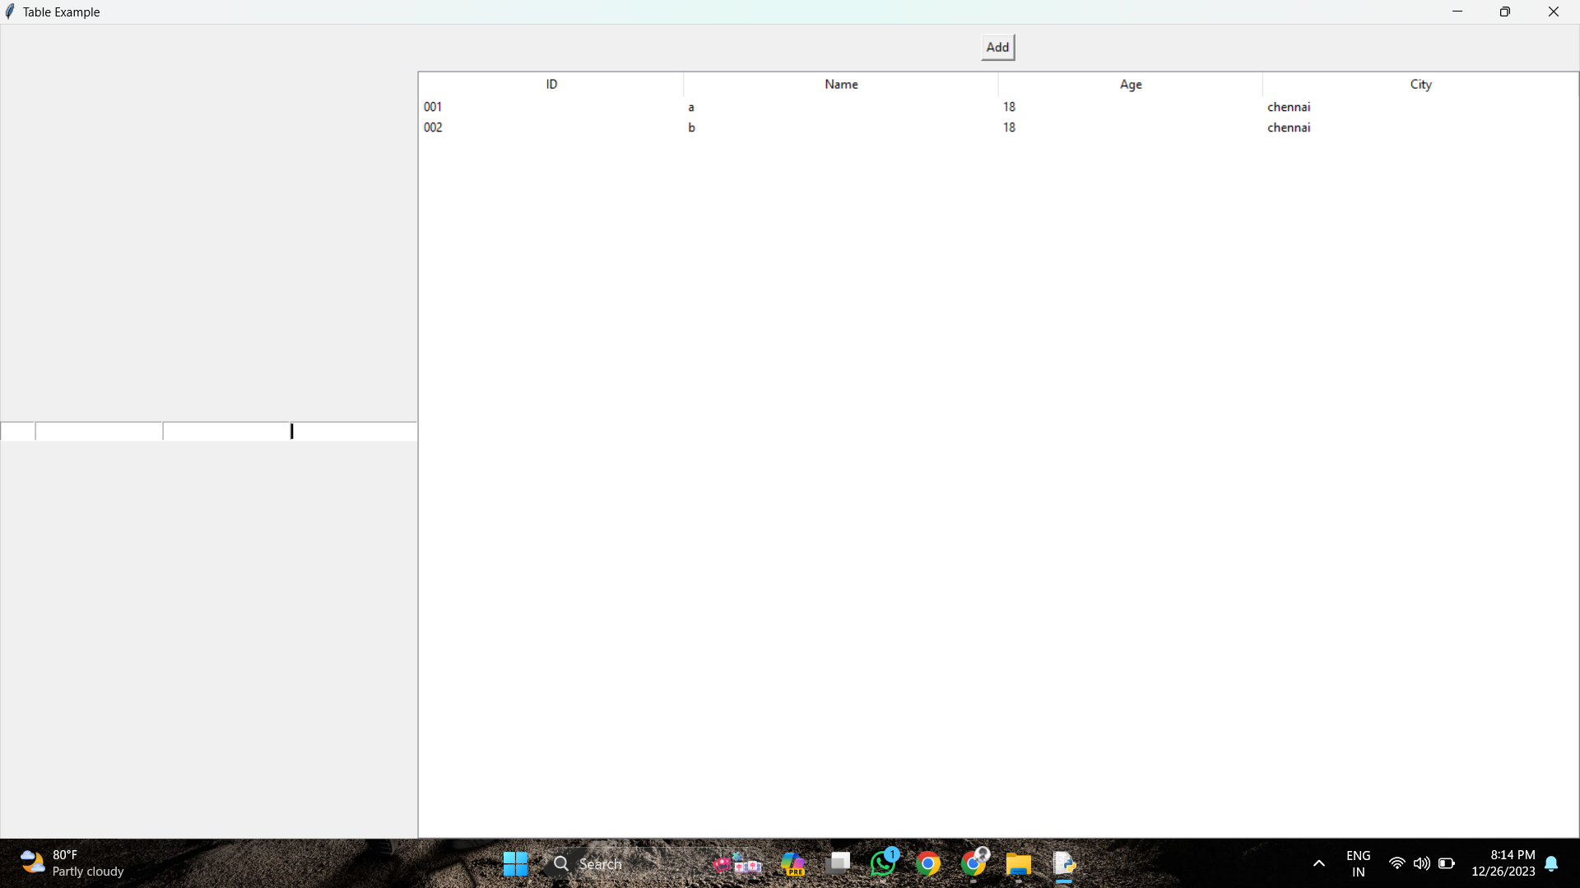
OUTPUT

Slide 6
Module Used
tkinter: This is the standard GUI (Graphical User Interface) toolkit for Python. It provides a set of tools for creating desktop applications with graphical user interfaces.
ttk (Themed Tkinter): It is a module within tkinter that provides access to the Tk themed widget set. The ttk.Treeview widget is used for displaying hierarchical data in a tabular form (like a table).

Slide 7
Module Explanation
tk.Tk(): Creates the main window of the application.
ttk.Treeview(root): Creates a treeview widget, which is used as a table to display data.
tk.Entry(root): Creates an entry widget, which is a text box for user input.
tk.Button(root): Creates a button widget, which can trigger a function when clicked.
self.tree.insert(...): Inserts a new row of data into the treeview (table).
self.add_data(): Function triggered when the "Add" button is clicked. It retrieves data from entry widgets and adds a new row to the table.

